Slide 1
Extract Transform Load
ETL World Travel Data

Slide 2

Global Economic Impact of $7.6 trillion

Slide 3

Extraction
Narrow query field to very specific factors.
Focused on top rated destinations from popular travel sites.
Lonelyplanet.com
Thisisinsider.com
Tripadvisor.com
Travelandleisure.com

Slide 4

Extraction Challenges
Not all site are equal!
We utilized different methods to scrape data from websites.
from splinter import Browser
from selenium import webdriver
from bs4 import BeautifulSoup as bs
import requests

Slide 5
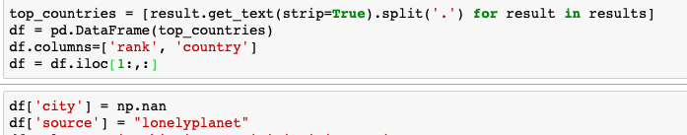
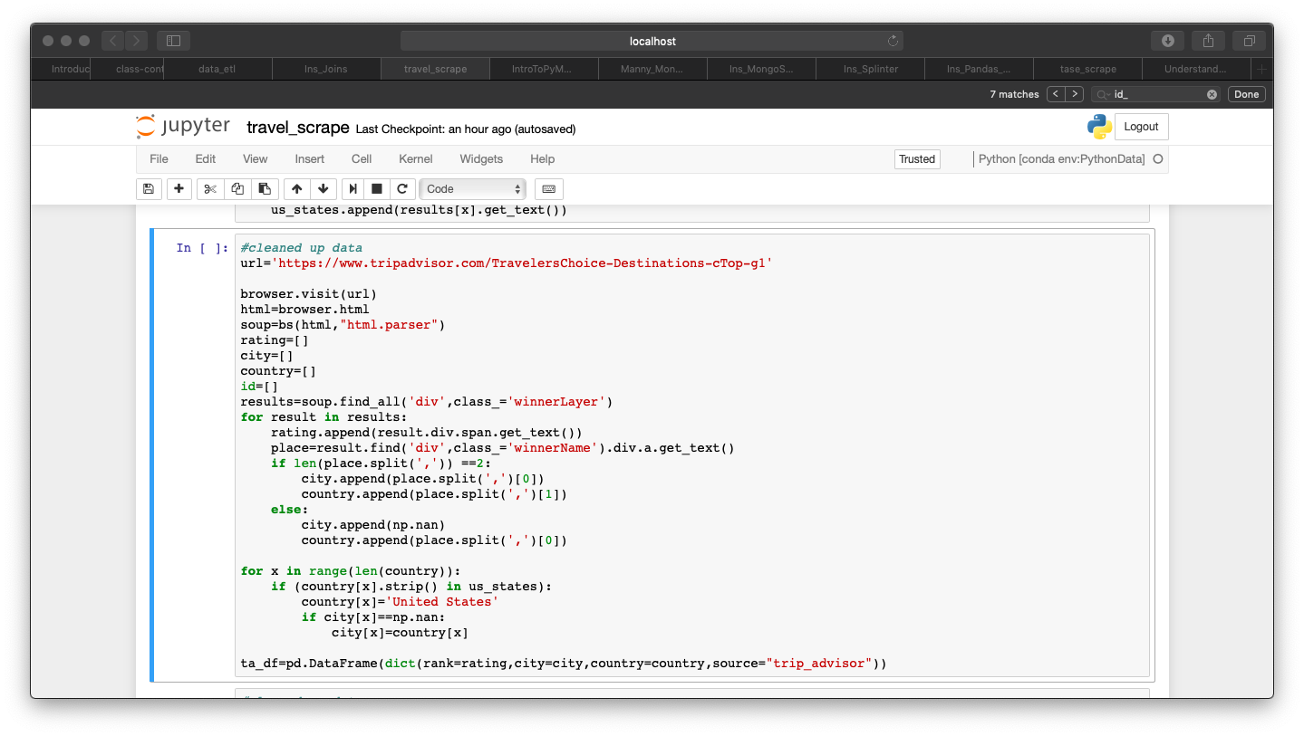
Transformation
Jupyter Notebook was utilized as our ”staging server”.
Transformation Tasks
Selection
Matching
Data Cleaning
Consolidation
Key restructuring

Slide 6
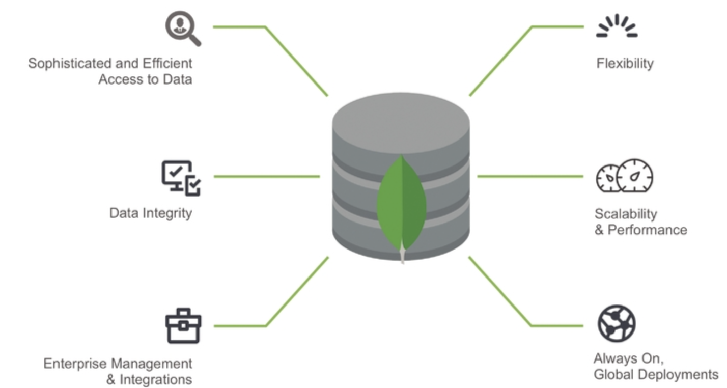
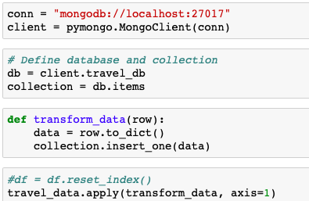
Load
MongoDB was utilized to store our data through pymongo.
MongoDB allows for:
Initial load: uploading everything for the first time.
Full Refresh: completely erasing the contents and reloading fresh data.
Incremental Load: applying ongoing changes as necessary in a periodic manner

Slide 7

Questions?
THANK YOU!
TEAM 2: Karuna Raina, Sai Kondrakunta, Tomas Resendiz

